Slide 1


Building Trust in Fintech: DevSecOps Strategies at Saxo Bank
Jinhong Brejnholt
Chief Cloud Architect
jbrejnholt

Slide 2
Astruct
At Saxo Bank, the cornerstone of our trading platform's integrity is our DevSecOps approach, which ensures top-tier security and code quality. This talk will highlight our security gates that empower developers to produce secure code from the get-go and govern our platform's continuous evolution. We'll delve into our 'shift left' strategy, which integrates security early in the development process for rapid feedback and enhanced efficiency. Discover how these practices enable us to maintain a secure, reliable, and trustworthy trading environment for our customers and partners.

Slide 3




3
jbrejnholt

Slide 4
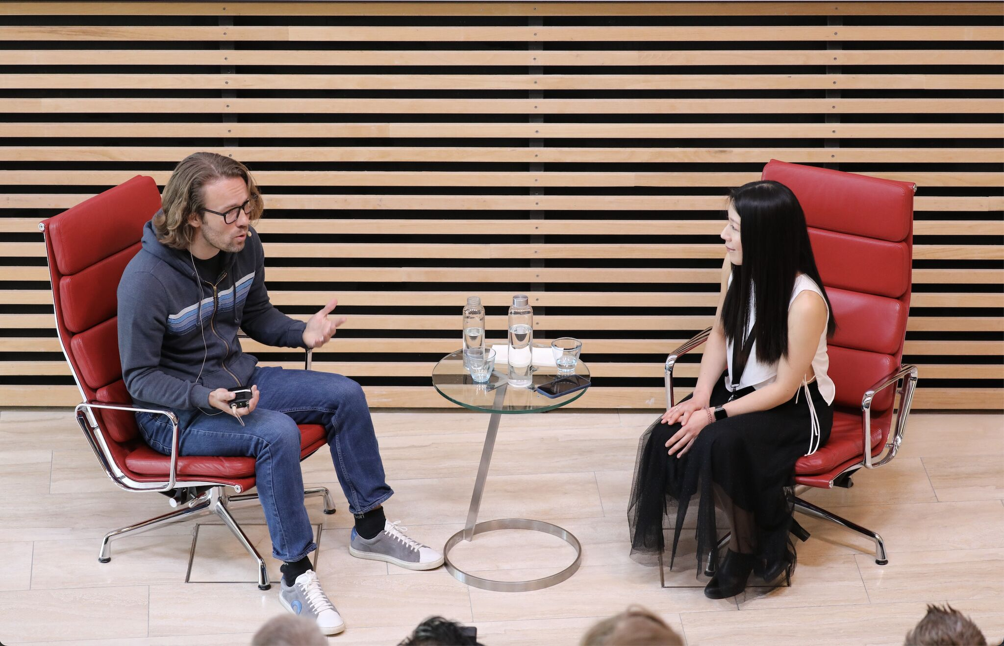
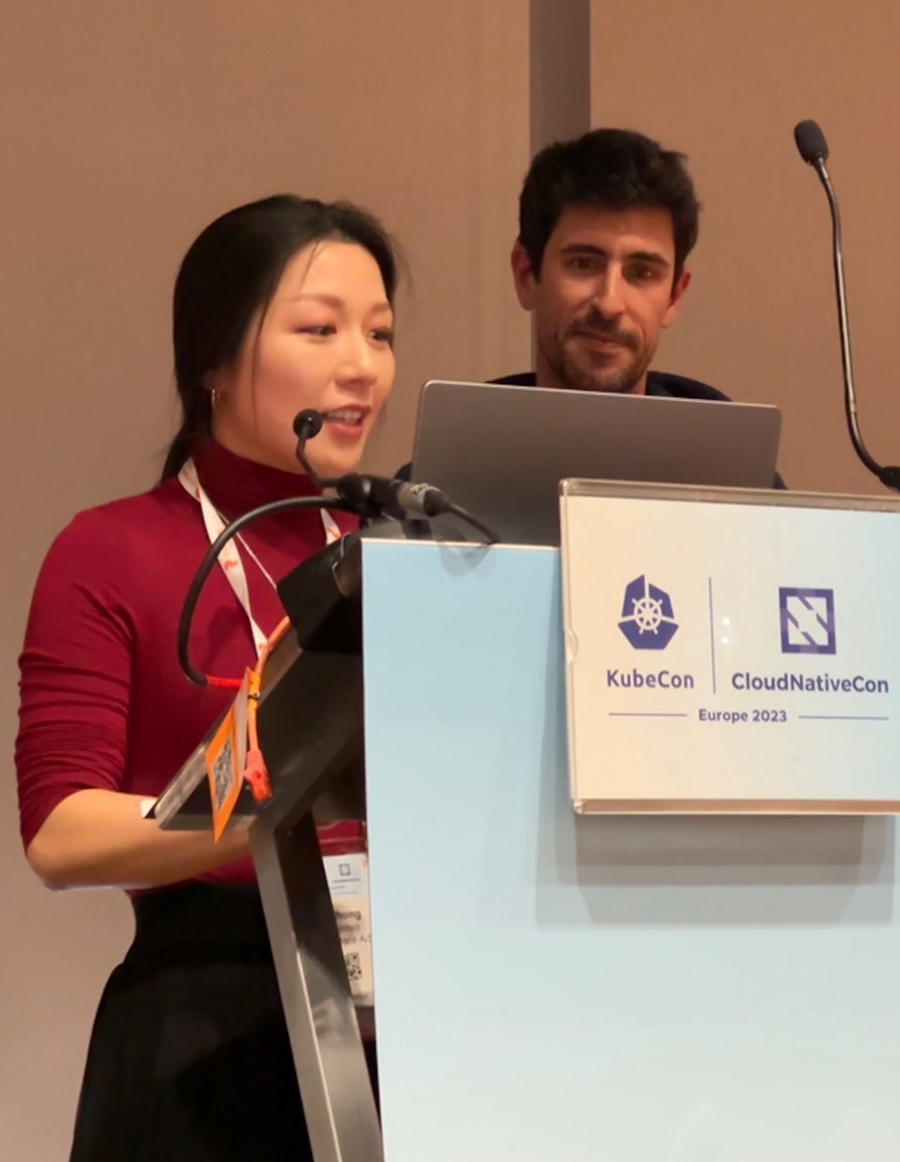
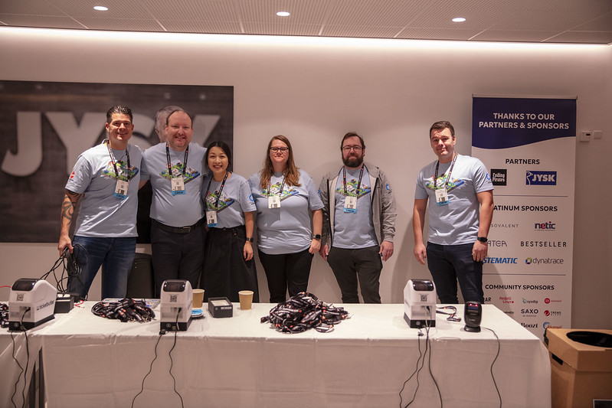
Cloud Native Community
Tuesday, February 2, 20XX
jbrejnholt
2 September 2024

Slide 5

About Saxo
Online trading and investment
17 billion USD daily trade
200+ banks and brokers
1.2 million clients
DKK 800 billion (USD 116.1 billion) in client assets
5
jbrejnholt
Notes:
Saxo Bank is a Danish investment bank specializing in online trading and investment. It was founded as a brokerage firm in 1992, under the name Midas Fondsmæglerselskab, by Lars Seier Christensen, Kim Fournais, and Marc Hauschildt. The name was changed to Saxo when the company obtained a banking license in 2001.
Saxo Bank A/S is a fully licensed and regulated Danish bank with an online trading platform that empowers you to invest across global financial markets.

Slide 6

Trust
6
jbrejnholt

Slide 7
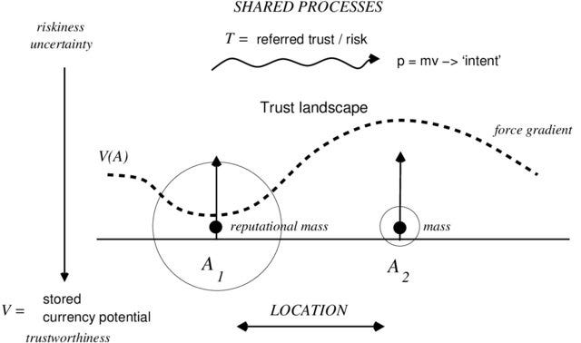
Measure Trust
jbrejnholt
Notes:
Consistency - How reliably someone behaves over time.
Transparency - How open and clear someone is about their actions and intentions.
Alignment of Interests - How well someone's goals align with yours.
Medium
Trust and Trustability
How Promise Theory tells us trust is really an economy of attention

Slide 8
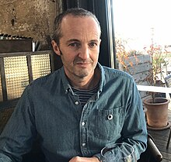
Trust
Trust as a prediction about someone's behavior based on their past actions, reliability, and intentions.
Trust is built over time through consistent and predictable behavior.
Source: Trust and Trustability
Mark Burgess
Independent researcher and writer. Formerly professor at Oslo University College.
Known for Promise Theory.
jbrejnholt
Notes:
Medium
Trust and Trustability
How Promise Theory tells us trust is really an economy of attention
I would not trust my mom to restart my computer.
But we are here to talk about building trust in financial institution today..

Slide 9

Poll
9
jbrejnholt

Slide 10
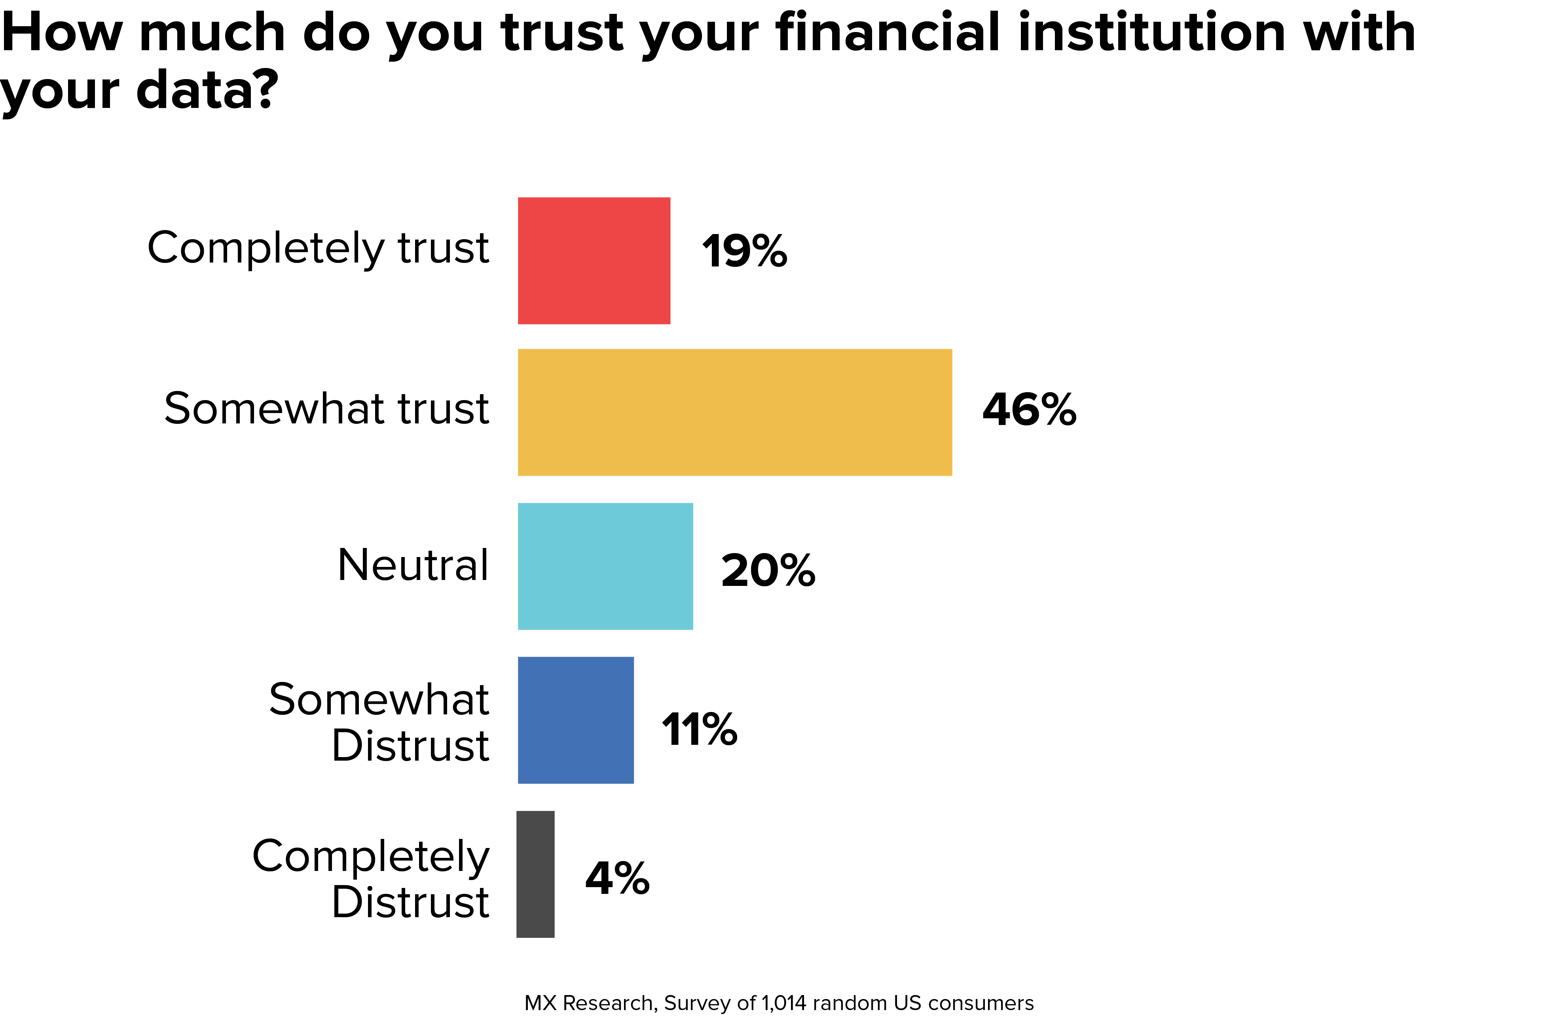
jbrejnholt
Notes:
Worry about the last 4% - where do you save the cash

Slide 11
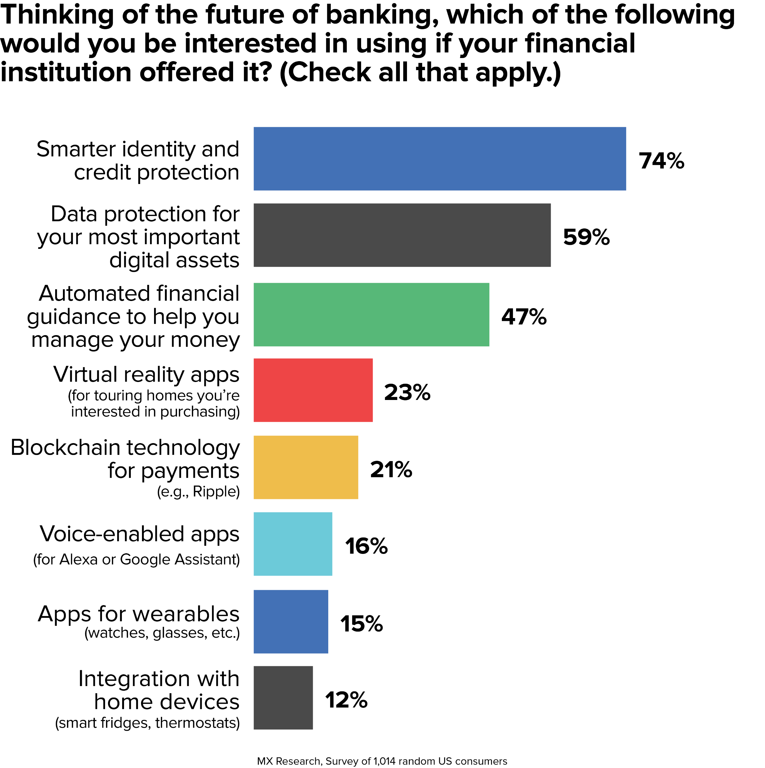
11
jbrejnholt
Notes:
The most desired features are all security related - not financial guidance! Protect my identity first then we talk.

Slide 12


12
jbrejnholt
Notes:
As an investment bank, we would like to offer the best services – securely!

Slide 13

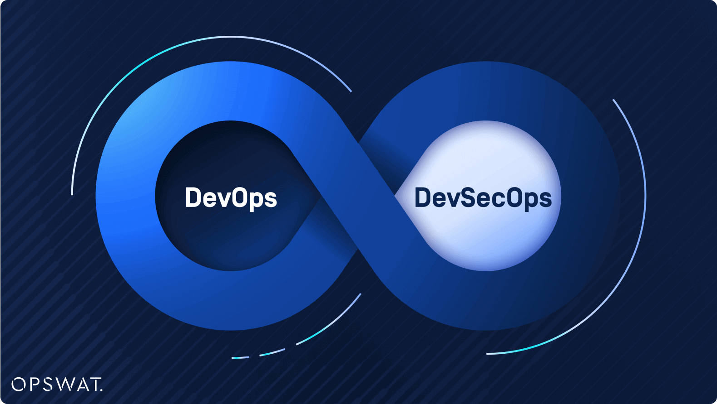

Notes:
DevSecOps stands for Development, Security, and Operations, is a framework that integrates security into all phases of the software development lifecycle.
Click -> now people also call it "platform engineering"
PE is DevOps done right – systematic way of thinking and offering good DevEx
Organizations adopt this approach to reduce the risk of releasing code with security vulnerabilities.
Through collaboration, automation, and clear processes, teams share responsibility for security, rather than leaving it to the end when issues can be much more difficult and costly to address.

Slide 14
The Ratio
Dev : Ops : Sec
? : ? : ?
14
jbrejnholt
Notes:
No matter the terms - we have similar challenge
We are a bank – but we can’t print our own money
We are facing the same security and compliance challenge through out the Software development lifecycle as everyone else
Take a look with all the areas which need security coverage

Slide 15
The Ratio
Dev : Ops : Sec
200 : 5 : 1
15
jbrejnholt
Notes:
We are a bank – but we can’t print our own money
We are facing the same security and compliance challenge through out the Software development lifecycle as everyone else
Take a look with all the areas which need security coverage

Slide 16



Bulid
Deploy
Run
jbrejnholt
Notes:
Well, it might be.
Put all steps in the circles into three bucket, and see what's expected from our developers.

Slide 17




Bulid
Deploy
Run
jbrejnholt
Notes:
Internal
Code Quality
Test Coverage
External
License Compliant
Vulnerabilities Management

Slide 18


Bulid
Deploy
Run
jbrejnholt
Notes:
Exam test coverage and code quality
Package Vulnerabilities
3rd party software License
Artifact Integrity
Change Process

Slide 19
Bulid
Deploy
Run
jbrejnholt
Notes:
Exam test coverage and code quality
Package Vulnerabilities
3rd party software License
Artifact Integrity
Change Process

Slide 20





Bulid
Deploy
Run
jbrejnholt
Notes:
Package Vulnerabilities
3rd party software License
Policy enforcement on Security & Best Practices
Behavior Monitoring

Slide 21
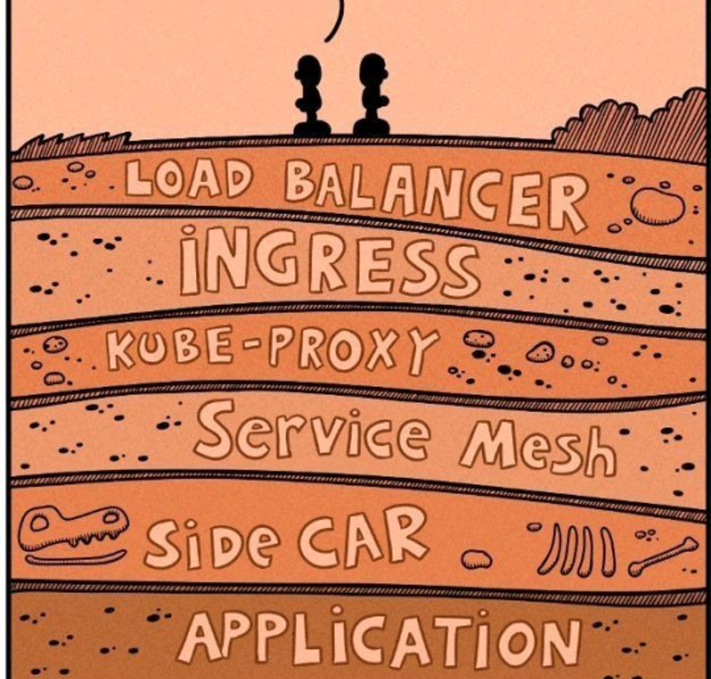
The story doesn’t just end here
21
jbrejnholt

Slide 22
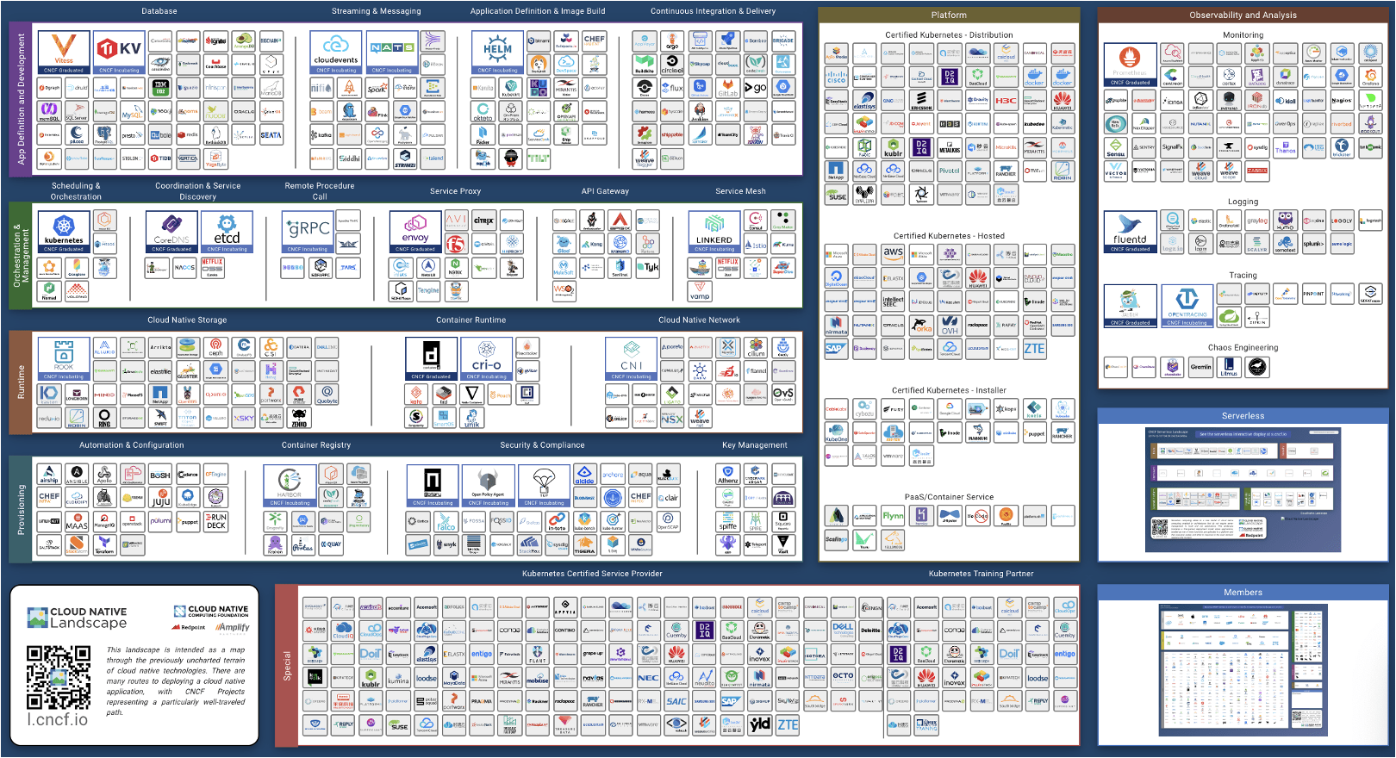
22
jbrejnholt
Notes:
The lanscape is huge
There is always a new ServiceMesh option worth investigating

Slide 23
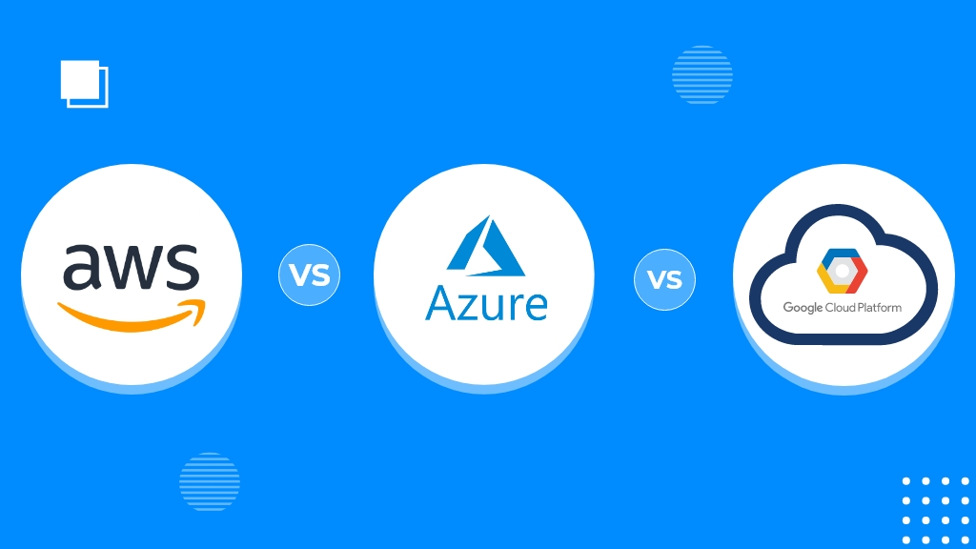

Managed Services
200+
200+
100+
23
jbrejnholt
Notes:
Did I forget to mention the cloud providers?
AWS lamda/S3/RDS
Azure purview/managed instance/frontdoor
Google BigQuery

Slide 24
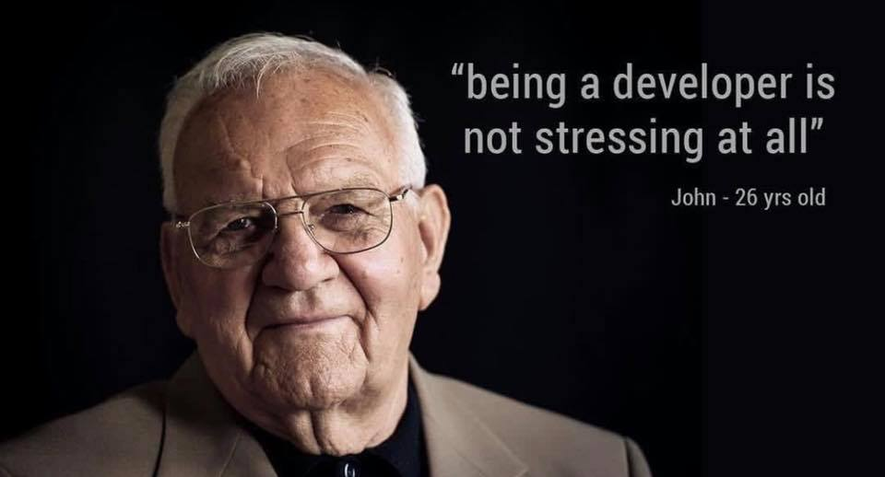
24

Slide 25

Stack Overflow’s 2020 Developer Survey
Source: https://survey.stackoverflow.co/2020
65K developers
15% - anxiety, depression, or another mental issue
83% of developers report burnout
jbrejnholt

Slide 26

DevSecOps?
26
jbrejnholt
Notes:
You might think – hey, I thought we were talking about DevSecOps?

Slide 27
DevSecOps? Platform Engineering
27
jbrejnholt
Notes:
You might think – hey, I thought we were talking about DevSecOps?

Slide 28


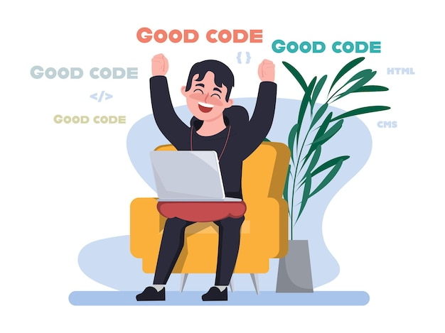
28
jbrejnholt
Notes:
Yep!

Slide 29
Bulid
Deploy
Run
jbrejnholt
Notes:
Ask developers to figure out all these requirement is not sustained

Slide 30
Bulid
Deploy
Run
jbrejnholt
Notes:
We need to Build-in security to support all

Slide 31

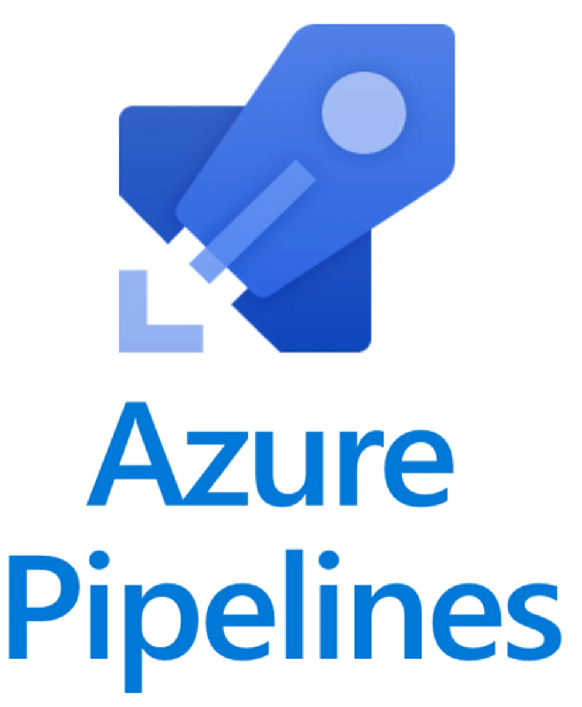

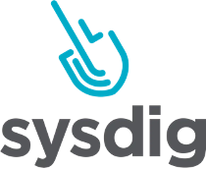
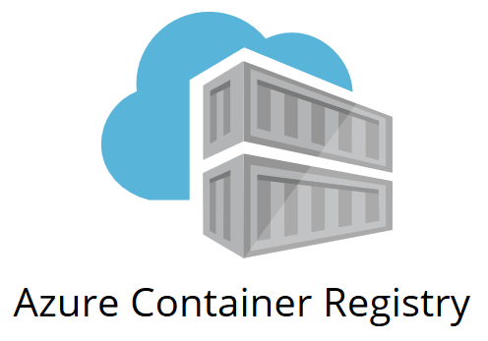



Bulid
Deploy
Run
jbrejnholt
Notes:
Exam test coverage and code quality
Package Vulnerabilities
3rd party software License
Artifact Integrity
Change Process

Slide 32
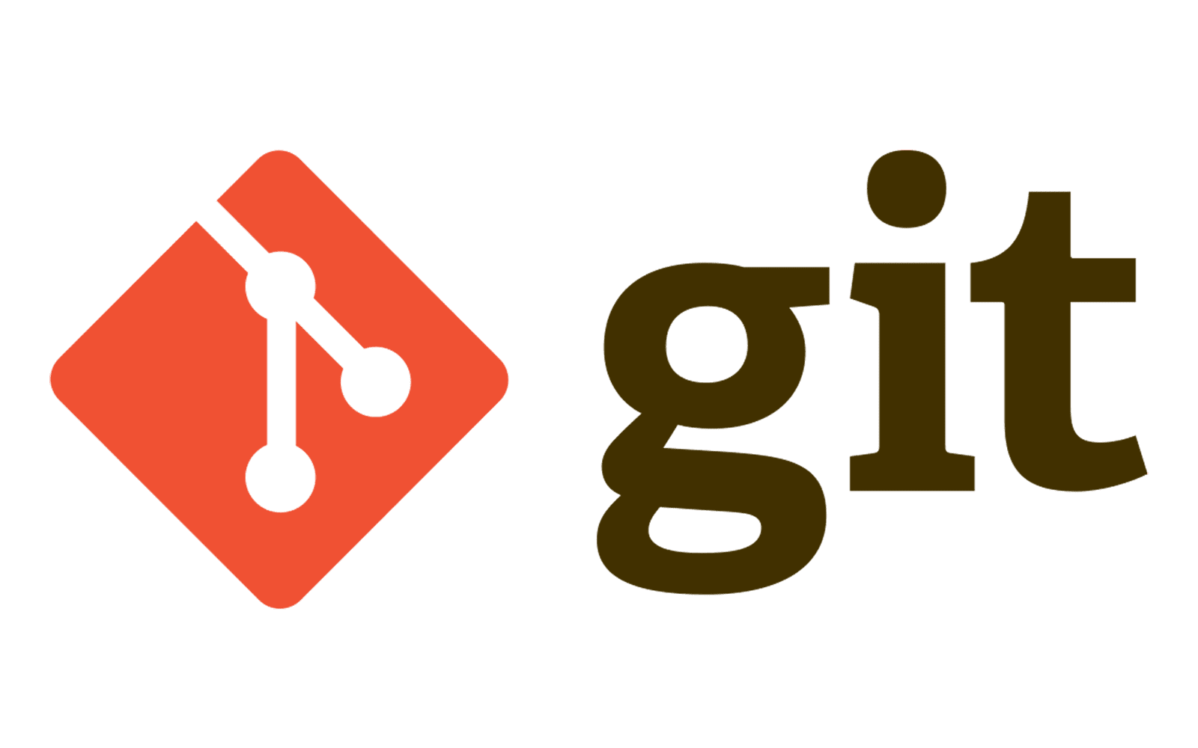
Bulid
Deploy
Run
jbrejnholt
Notes:
Exam test coverage and code quality
Package Vulnerabilities
3rd party software License
Artifact Integrity
Change Process

Slide 33
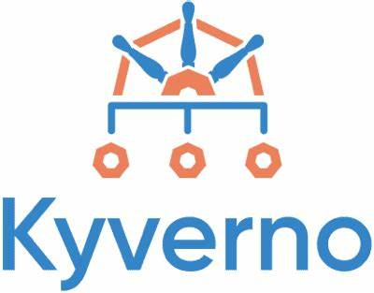



Bulid
Deploy
Run
jbrejnholt
Notes:
Exam test coverage and code quality
Package Vulnerabilities
3rd party software License
Artifact Integrity
Change Process

Slide 34
Bulid
Deploy
Run
jbrejnholt
Notes:
That’s still a lot to learn – I don’t even recognize all the icons

Slide 35





Bulid
Deploy
Run
jbrejnholt
Notes:
Faster delivery
Improved security posture and integration
Reduced costs
Better product – better trust

Slide 36





Bulid
Deploy
Run
jbrejnholt
Notes:
Production is where most attacks happen.
Scanning source code can’t give you the same rich insights you can get by observing the application when it is running in production.
Some applications you run in production may not have run through your dev environment, so they never had a chance to be scanned by security tools in your dev environment.
To detect new zero-day vulnerabilities, you need to monitor existing applications in your production environment.

Slide 37


Slide 38


Bulid
Deploy
Run
jbrejnholt
Notes:
Fear not. Ta ta -> IDP is what you need

Slide 39

Celebrate?
39
jbrejnholt

Slide 40

Continue Evaluating and Improving
jbrejnholt

Slide 41




Recommendations
Policy as Code
Investment
Chaos Engineering
Iteration
Automation
Upskill Devs
Start Small
Governance
Diagnosis
* 3
Notes:
Automation: scripting and/or operator

Slide 42

Recommendations
Policy as Code
Investment
Chaos Engineering
Iteration
Automation
Upskill Devs
Start Small
Governance
Diagnosis
* 3

Slide 43




Finally…
Notes:
“DevOps and Platform Engineering are NOT about fancy tools or shiny pipelines. They’re about EMPOWERING developers to deliver business value—FASTER, SAFER, and EASIER.”
Key Points (with Icons):
🚫 No Vanity Projects: Don’t build pipelines or platforms that look cool but do nothing.
💡 Focus on Value: Everything you build should reduce friction for developers.
🏃‍♂️ Make It Faster: Speed up delivery without compromising quality.
🛡️ Make It Safer: Ensure every change is secure and reliable.
🛠️ Make It Easier: Simplify the developer’s experience, not complicate it.

Slide 44


Thank You
jbrejnholt
Notes:
CPH

